Slide 1

Working with the IRIS DMC: Accessing Data
TIM AHERN, DIRECTOR, IRIS DATA SERVICES
Training in Network Management Systems and Analytical Tools for Seismology • 23–27 October 2017 • Baku, Azerbaijan

Slide 2
Accessing the IRIS DMC for data
Traditional methods
  BREQ_FAST
  BREQ_FAST through SeismiQuery
Web Applications
  WILBER 3
Clients
  PyWeed
Streaming data
  SEEDLink
  SeedLink Clients (Seisgram2k)
Web services and clients
  URL Builders
  fetchdata
    Federated option
Training in Network Management Systems and Analytical Tools for Seismology • 23–27 October 2017 • Baku, Azerbaijan

Slide 3
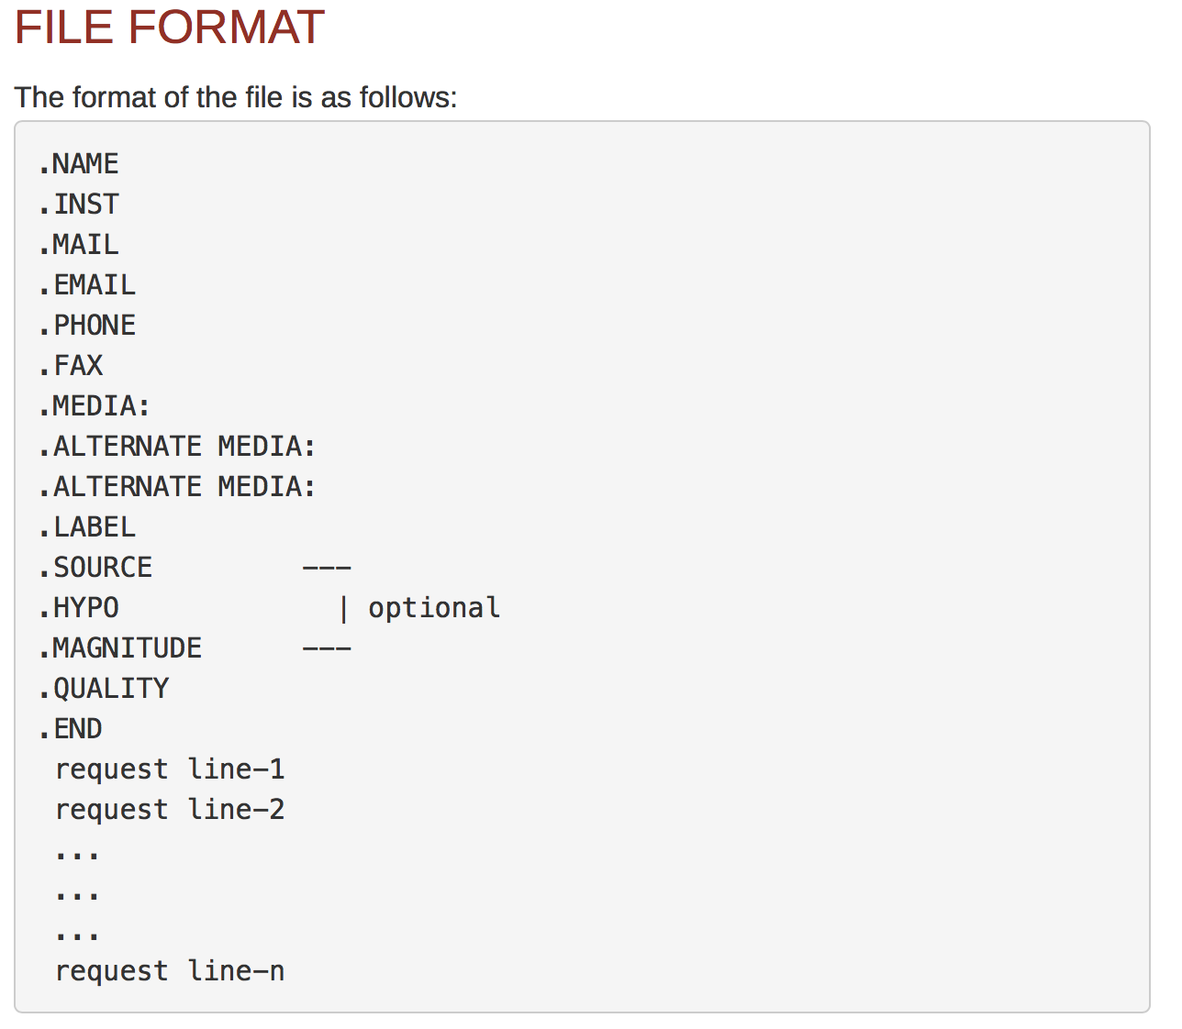
BREQ_FAST an email based tool
BREQ_FAST Manual
Training in Network Management Systems and Analytical Tools for Seismology • 23–27 October 2017 • Baku, Azerbaijan

Slide 4
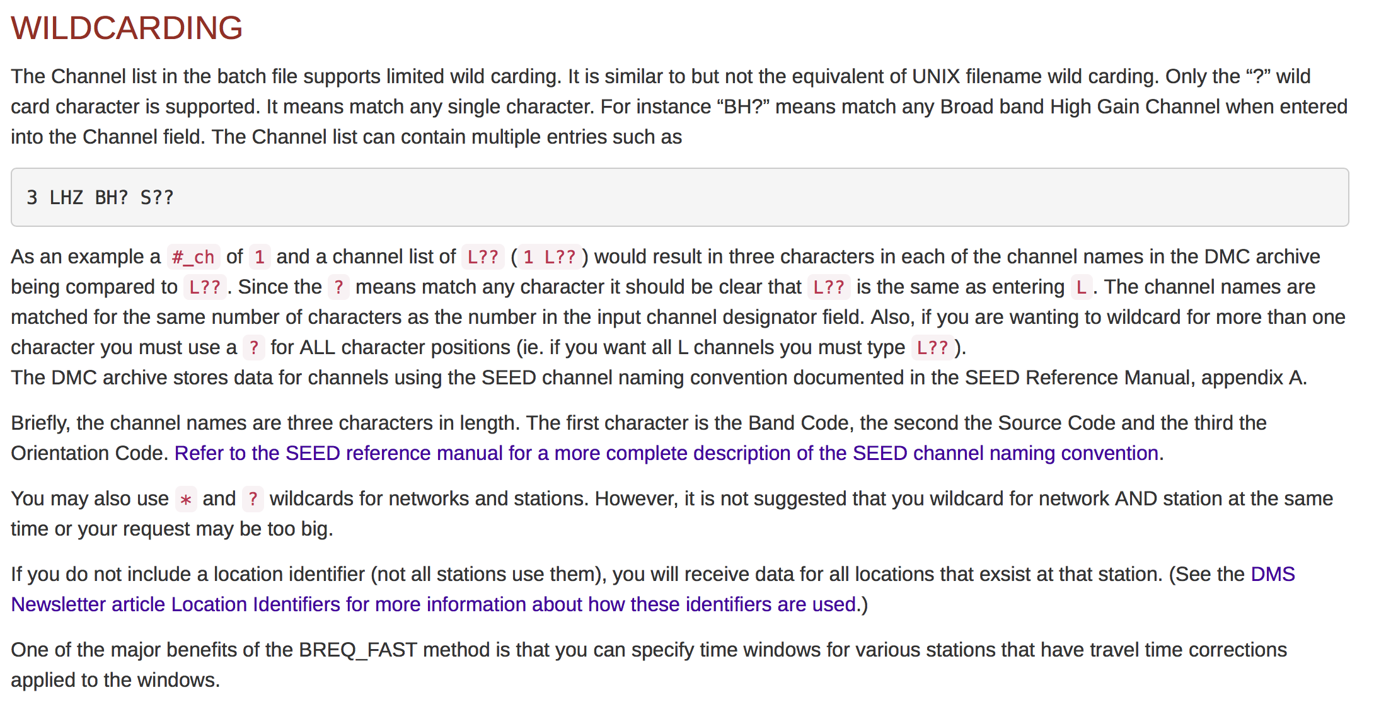
Wildcarding
Training in Network Management Systems and Analytical Tools for Seismology • 23–27 October 2017 • Baku, Azerbaijan

Slide 5
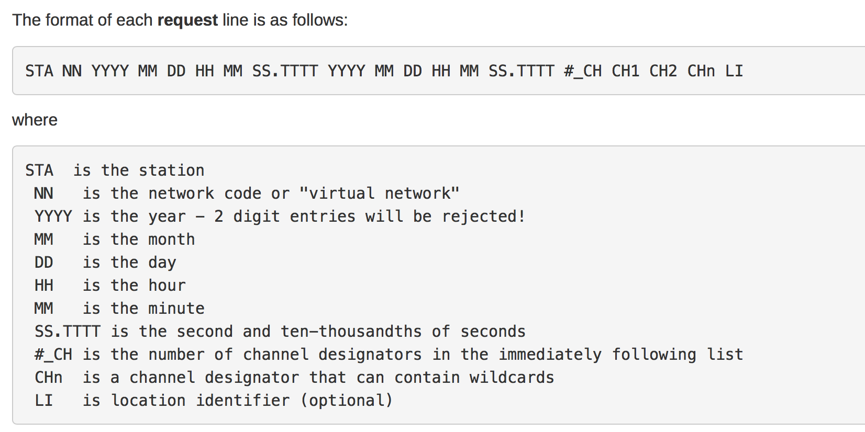
BREQ_FAST Request Lines
Training in Network Management Systems and Analytical Tools for Seismology • 23–27 October 2017 • Baku, Azerbaijan

Slide 6
Is something wrong with your BREQ_FAST?
Composing your BREQ_FAST request manually is fine but you have no idea if the IRIS DMC actually has the data you are requesting.
The solution…BREQ_FAST through SeismiQuery
Training in Network Management Systems and Analytical Tools for Seismology • 23–27 October 2017 • Baku, Azerbaijan

Slide 7
Accessing the IRIS DMC for data
Traditional methods
  BREQ_FAST
  BREQ_FAST through SeismiQuery
Web Applications
  WILBER 3
Clients
  PyWeed
Streaming data
  SEEDLink
  SeedLink Clients (Seisgram2k)
Web services and clients
  URL Builders
  fetchdata
    Federated option
Training in Network Management Systems and Analytical Tools for Seismology • 23–27 October 2017 • Baku, Azerbaijan

Slide 8
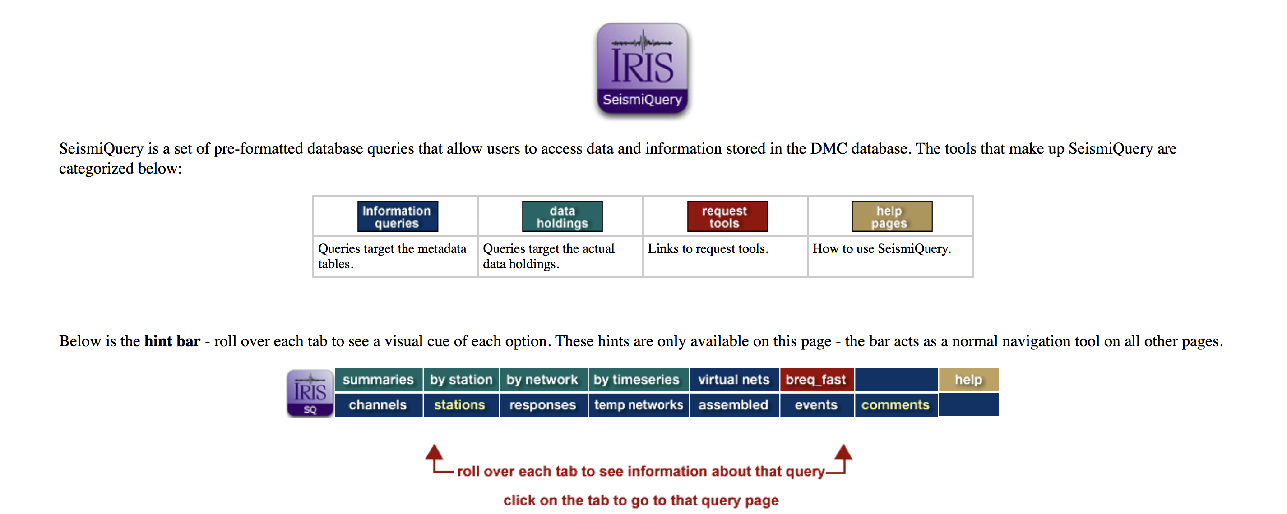
BREQ_FAST Using SeismiQuery http://ds.iris.edu/SeismiQuery/
Training in Network Management Systems and Analytical Tools for Seismology • 23–27 October 2017 • Baku, Azerbaijan

Slide 9
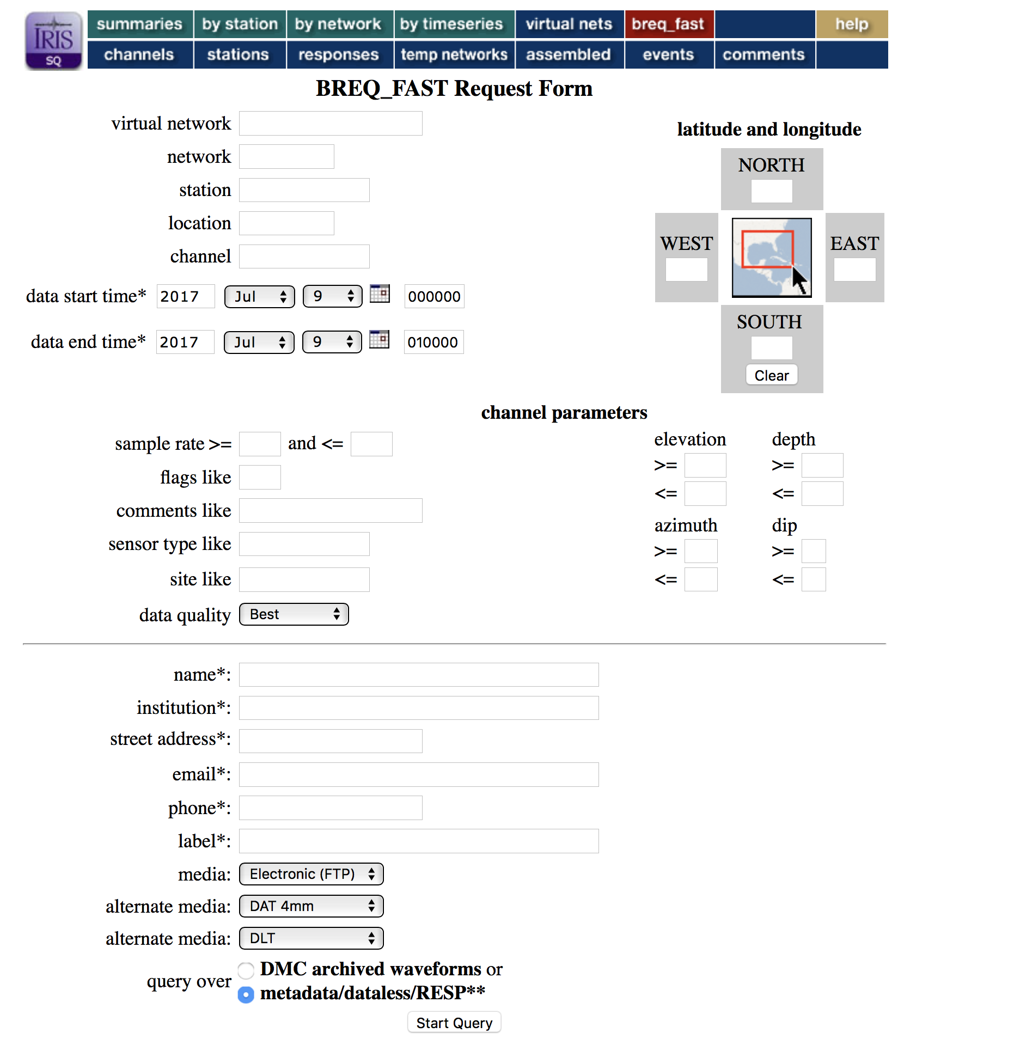
BREQ_FAST Request Form
Supports Wildcards ? and *
Leaving fields blank is *
Most fields can be comma separated lists
Training in Network Management Systems and Analytical Tools for Seismology • 23–27 October 2017 • Baku, Azerbaijan

Slide 10
An exercise using BREQ_FAST
.NAME Your Name
.INST Your Institution
.ADDRESS Your Address
.EMAIL Your Email
.PHONE Your phone
.FAX Your fax
.MEDIA: FTP
.ALTERNATE MEDIA: DAT
.ALTERNATE MEDIA: DLT3
.LABEL Workshop.Test
.FROM SQ
.QUALITY B
.END
AAK II 2017 09 04 00 00 00.0000 2017 09 04 01 00 00.9999 1 BH1 00
AAK II 2017 09 04 00 00 00.0000 2017 09 04 01 00 00.9999 1 BH2 00 AAK II 2017 09 04 00 00 00.0000 2017 09 04 01 00 00.9999 1 BHZ 00
Training in Network Management Systems and Analytical Tools for Seismology • 23–27 October 2017 • Baku, Azerbaijan

Slide 11
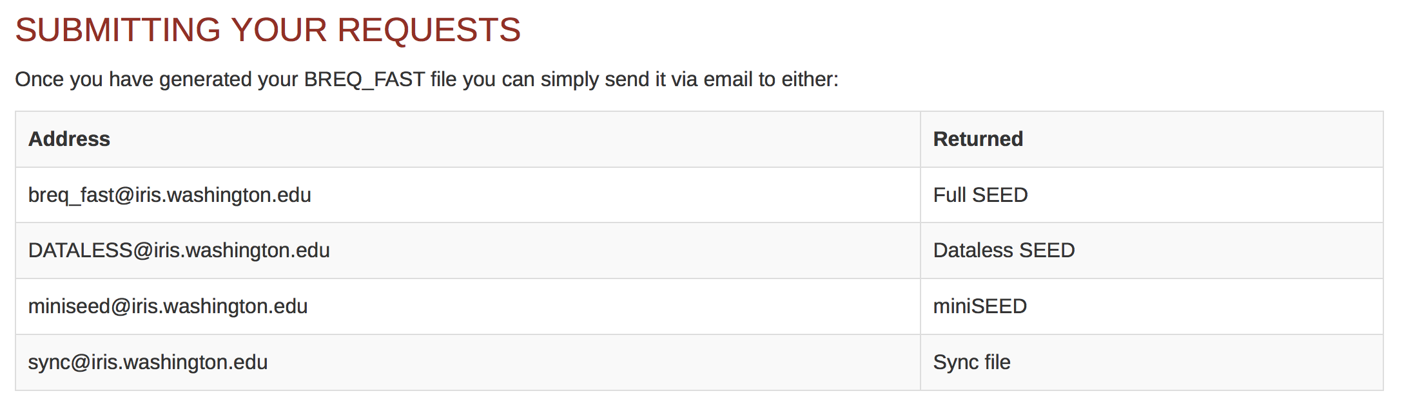
Submitting a BREQ_FAST Request
Training in Network Management Systems and Analytical Tools for Seismology • 23–27 October 2017 • Baku, Azerbaijan

Slide 12
Accessing the IRIS DMC for data
Traditional methods
  BREQ_FAST
  BREQ_FAST through SeismiQuery
Web Applications
  WILBER 3
Clients
  PyWeed
Streaming data
  SEEDLink
  SeedLink Clients (Seisgram2k)
Web services and clients
  URL Builders
  fetchdata
    Federated option
Training in Network Management Systems and Analytical Tools for Seismology • 23–27 October 2017 • Baku, Azerbaijan

Slide 13
WILBER3 – Web Application
WILBER3 is an interactive web based tool that allows simple access to data for a single event
WILBER3
  Select event of interest
    Space, time, and magnitude criteria
  Select Stations
    Distance and azimuth
  Plot a record section
  Make Request
    Phase windows, data formats
  Download the data
Training in Network Management Systems and Analytical Tools for Seismology • 23–27 October 2017 • Baku, Azerbaijan

Slide 14
Try this Wilber3 Data Request
    2017-04-05 Mww6.1 Northern and Central Iran
    All Stations from 0-15 degrees from event
    BH? Channels
    Generate a Record Section
      1 minute before P arrival to 10 minutes after P
    Then request the data in 2 column ascii format
    Take 10 Minutes for you to try this
Training in Network Management Systems and Analytical Tools for Seismology • 23–27 October 2017 • Baku, Azerbaijan

Slide 15
Accessing the IRIS DMC for data
Traditional methods
  BREQ_FAST
  BREQ_FAST through SeismiQuery
Web Applications
  WILBER 3
Clients
  PyWeed
Streaming data
  SEEDLink
  SeedLink Clients (Seisgram2k)
Web services and clients
  URL Builders
  fetchdata
    Federated option
Training in Network Management Systems and Analytical Tools for Seismology • 23–27 October 2017 • Baku, Azerbaijan

Slide 16
PyWEED – requesting data from multiple events and stations
PyWEED is written in Python and runs on all modern operating systems.
It is used to request data from multiple events from multiple stations
Returns data in
  miniSEED
  SAC/ SAC ASCII
  2 text file options
  Available in GitHub at
    https://github.com/iris-edu/pyweed
Training in Network Management Systems and Analytical Tools for Seismology • 23–27 October 2017 • Baku, Azerbaijan

Slide 17
Accessing the IRIS DMC for data
Traditional methods
  BREQ_FAST
  BREQ_FAST through SeismiQuery
Web Applications
  WILBER 3
Clients
  PyWeed
Streaming data
  SEEDLink
  SeedLink Clients (Seisgram2k)
Web services and clients
  URL Builders
  fetchdata
    Federated option
Training in Network Management Systems and Analytical Tools for Seismology • 23–27 October 2017 • Baku, Azerbaijan

Slide 18
Streaming Data
Applications that can accept streaming data in SeedLink format
  SeisComp3
    Bernd Weber (SeisComp3) and
  ObsPy
    Tobias Megies (ObsPy) will cover SeedLink in much greater detail
  SeisGram2K
    a free application frm Anothony Lomax for display of real time data through SeedLink
    http://alomax.free.fr/seisgram/ver60/SeisGram2K_install.html
Training in Network Management Systems and Analytical Tools for Seismology • 23–27 October 2017 • Baku, Azerbaijan

Slide 19
Accessing the IRIS DMC for data
Traditional methods
  BREQ_FAST
  BREQ_FAST through SeismiQuery
Web Applications
  WILBER 3
Clients
  PyWeed
Streaming data
  SEEDLink
  SeedLink Clients (Seisgram2k)
Web services and clients
  URL Builders
  fetchdata
    Federated option
Training in Network Management Systems and Analytical Tools for Seismology • 23–27 October 2017 • Baku, Azerbaijan

Slide 20
Web Services
FDSN Web Services
  Station – metadata about stations
  Event – event catalogs
  Dataselect – time series data
IRIS has many others
  IRIS web services can be found at service.iris.edu
  IRIS Web Services
Lets investigate the station service
Training in Network Management Systems and Analytical Tools for Seismology • 23–27 October 2017 • Baku, Azerbaijan

Slide 21
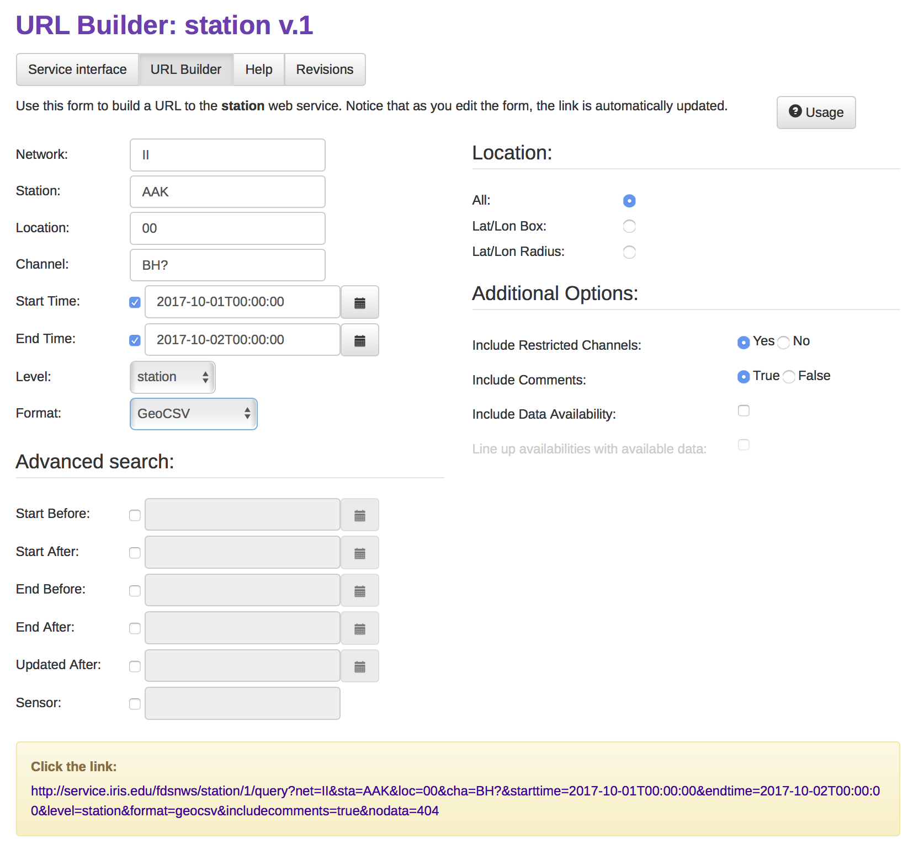
The Station URL Builder

Slide 22
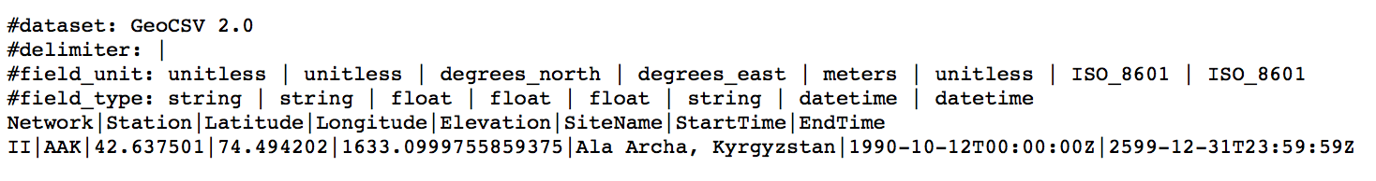
Stations information in GeoCSV text format
Training in Network Management Systems and Analytical Tools for Seismology • 23–27 October 2017 • Baku, Azerbaijan

Slide 23
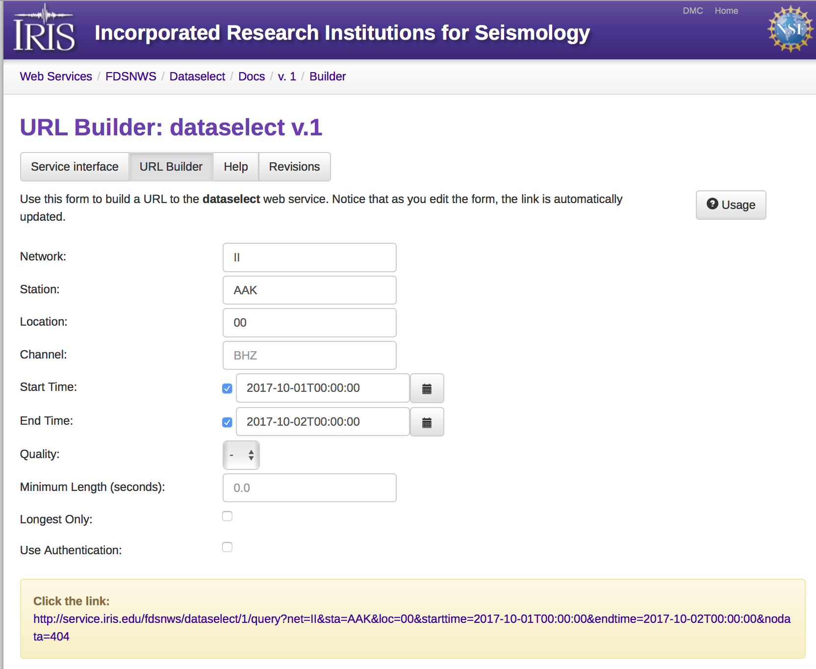
Dataselect service – access to miniSeed
Training in Network Management Systems and Analytical Tools for Seismology • 23–27 October 2017 • Baku, Azerbaijan

Slide 24
Accessing the IRIS DMC for data
Traditional methods
  BREQ_FAST
  BREQ_FAST through SeismiQuery
Web Applications
  WILBER 3
Clients
  PyWeed
Streaming data
  SEEDLink
  SeedLink Clients (Seisgram2k)
Web services and clients
  URL Builders
  fetchdata
    Federated option
Training in Network Management Systems and Analytical Tools for Seismology • 23–27 October 2017 • Baku, Azerbaijan

Slide 25
Fetchdata primary options
-v Increase verbosity, may be specified multiple times
-s starttime Specify start time (YYYY-MM-DD,HH:MM:SS.ssssss)
-e endtime Specify end time (YYYY-MM-DD,HH:MM:SS.ssssss
--lat min:max Specify a minimum and/or maximum latitude range
--lon min:max Specify a minimum and/or maximum longitude range
--radius lat:lon:maxradius[:minradius]
Specify circular region with optional minimum radius
-o outfile Fetch time series data and write to output file
-m metafile Write basic metadata to specified file
-F [DC1[,DC2]] Federate the request to multiple data centers if needed
Federation may be limited to an optional list of DCs
Output files are prefixed by data center identifiers
Training in Network Management Systems and Analytical Tools for Seismology • 23–27 October 2017 • Baku, Azerbaijan

Slide 26
Additional fetchdata options
-h Print this help message, if multiple print more help
-q Be quiet, do not print anything but errors
-N,--net Network code, list and wildcards (* and ?) accepted
-S,--sta Station code, list and wildcards (* and ?) accepted
-L,--loc Location ID, list and wildcards (* and ?) accepted
-C,--chan Channel codes, list and wildcards (* and ?) accepted
-Q,--qual Quality indicator, by default no quality is specified
-l listfile Read list of selections from file
-b bfastfile Read list of selections from BREQ_FAST file
-a user:pass User and password for access to restricted data
-sd sacpzdir Fetch SAC P&Zs and write files to sacpzdir
-rd respdir Fetch RESP and write files to respdir
Training in Network Management Systems and Analytical Tools for Seismology • 23–27 October 2017 • Baku, Azerbaijan

Slide 27
Executing Fetchdata
Perl script (enter the name without options for help)
  -s start time
  -e end time
  --radius enter the point and the radius
  -C channel
  -o output file name
  -m output metadata file name
  -v increase verbosity
  ./FetchData-2017.164.pl -s 2017-05-03T08:53:37 -e 2017-05-03T09:53:37 --radius 42.14:46.97:10 -C LHZ -o output/Georgia.mseed -m output/GeorgiaM5.2.meta –v
Training in Network Management Systems and Analytical Tools for Seismology • 23–27 October 2017 • Baku, Azerbaijan

Slide 28
Running Fetchdata
./FetchData-2017.164.pl -s 2017-05-03T08:53:37 -e 2017-05-03T09:53:37 --radius 42.14:46.97:15 -C LHZ -o output/Georgia.mseed -m output/GeorgiaM5.2.meta –v
Received 896 Bytes of metadata in 0.2 seconds (5.0 KB/s)
Processed metadata for 17 channel epochs in 0.2 seconds
Received 73.5 KB of time series data in 1.4 seconds (52.6 KB/s) - written to output/Georgia.mseed
Writing metadata (17 channel epochs) to file: output/GeorgiaM5.2.meta
DONE at 2017-10-16 13:42:28
Produced two files in the directory output
  Georgia.mseed
  GeorgiaM5.2.meta

Slide 29
Federation of Data Centers
Training in Network Management Systems and Analytical Tools for Seismology • 23–27 October 2017 • Baku, Azerbaijan

Slide 30
Executing a Federated Fetchdata
Perl script (enter the name without options for help)
  -s start time
  -e end time
  --radius enter the point and the radious
  -C channel
  -o output file name
  -m name of metadata file
  -v increase verbosity
  -F perform a federated search across data centers
  ./FetchData-2017.164.pl -s 2017-05-03T08:53:37 -e 2017-05-03T09:53:37 --radius 42.14:46.97:10 -C LHZ -o output/Georgia.mseed -m output/GeorgiaM5.2.meta –v -F
Training in Network Management Systems and Analytical Tools for Seismology • 23–27 October 2017 • Baku, Azerbaijan

Slide 31
Extracts information from federated catalog
./FetchData-2017.164.pl -s 2017-05-03T08:53:37 -e 2017-05-03T09:53:37 --radius 42.14:46.97:15 -C LHZ -o output/Georgia.mseed -m output/GeorgiaM5.2.meta -v -F
FetchData-2017.164.pl (2017.164) at 2017-10-16 13:52:56
Fetching federator catalog results :: 552 Bytes
Federator response code: 200
Received 552 Bytes from federator catalog in 0.4 seconds (1.5 KB/s)
Federation catalog results from 5 data center(s):

Slide 32
Data Center Capabilities
Data center: GEOFON, 12 selections
MetadataWS: http://geofon.gfz-potsdam.de/fdsnws/station/1
TimeSeriesWS: http://geofon.gfz-potsdam.de/fdsnws/dataselect/1
Data center: INGV, 3 selections
MetadataWS: http://webservices.ingv.it/fdsnws/station/1
TimeSeriesWS: http://webservices.ingv.it/fdsnws/dataselect/1Data center: IRISDMC, 14 selections
MetadataWS: http://service.iris.edu/fdsnws/station/1
TimeSeriesWS: http://service.iris.edu/fdsnws/dataselect/1
SACPZWS: http://service.iris.edu/irisws/sacpz/1
RESPWS: http://service.iris.edu/irisws/resp/1
Data center: NIEP, 1 selections
MetadataWS: http://eida-sc3.infp.ro/fdsnws/station/1
TimeSeriesWS: http://eida-sc3.infp.ro/fdsnws/dataselect/1
Data center: ORFEUS, 3 selections
MetadataWS: http://www.orfeus-eu.org/fdsnws/station/1
TimeSeriesWS: http://www.orfeus-eu.org/fdsnws/dataselect/1

Slide 33
Executing Federated Fetch
Fetching data from GEOFON (http://geofon.gfz-potsdam.de)
Fetching metadata :: 580 Bytes
Received 580 Bytes of metadata in 0.6 seconds (1.0 KB/s)
Parsing metadata and generating requests... Done (0.0 seconds)
Processed metadata for 12 channel epochs in 0.6 seconds
Fetching time series data (12 selections)
Downloading time series data (group 1 of 1) :: 55.0 KB
Received 55.0 KB of time series data in 1.7 seconds (32.4 KB/s) - written to output/GEOFON-Georgia.mseed
Writing metadata (12 channel epochs) to file: output/GEOFON-GeorgiaM5.2.meta
Fetching data from INGV (http://www.ingv.it)
Fetching metadata :: 230 Bytes
Received 230 Bytes of metadata in 0.4 seconds (616 Bytes/s)
Parsing metadata and generating requests... Done (0.0 seconds)
Processed metadata for 1 channel epochs in 0.4 seconds
Fetching time series data (1 selections)
Downloading time series data (group 1 of 1) :: No data available
Received 0 Bytes of time series data in 0.5 seconds (0 Bytes/s) - written to output/INGV-Georgia.mseed
Writing metadata (1 channel epochs) to file: output/INGV-GeorgiaM5.2.meta
Fetching data from IRISDMC (http://ds.iris.edu)
Fetching metadata :: 828 Bytes
Received 828 Bytes of metadata in 0.0 seconds (43.2 KB/s)
Parsing metadata and generating requests... Done (0.0 seconds)
Processed metadata for 14 channel epochs in 0.0 seconds
Fetching time series data (14 selections)
Downloading time series data (group 1 of 1) :: 67.5 KB
Received 67.5 KB of time series data in 0.8 seconds (85.7 KB/s) - written to output/IRISDMC-Georgia.mseed
Writing metadata (14 channel epochs) to file: output/IRISDMC-GeorgiaM5.2.meta

Slide 34
An issue when Data Centers don’t have what their metadata implies they have
Fetching data from NIEP (http://www.orfeus-eu.org/eida/eida_niep.html)
Fetching metadata :: 253 Bytes
Received 253 Bytes of metadata in 0.4 seconds (681 Bytes/s)
Parsing metadata and generating requests... Done (0.0 seconds)
Processed metadata for 1 channel epochs in 0.4 seconds
Fetching time series data (1 selections)
Downloading time series data (group 1 of 1) :: No data available
Received 0 Bytes of time series data in 0.4 seconds (0 Bytes/s) - written to output/NIEP-Georgia.mseed
Writing metadata (1 channel epochs) to file: output/NIEP-GeorgiaM5.2.meta
Fetching data from ORFEUS (http://www.orfeus-eu.org)
Fetching metadata :: 450 Bytes
Received 450 Bytes of metadata in 0.4 seconds (1.2 KB/s)
Parsing metadata and generating requests... Done (0.0 seconds)
Processed metadata for 3 channel epochs in 0.4 seconds
Fetching time series data (3 selections)
Downloading time series data (group 1 of 1) :: No data available
Received 0 Bytes of time series data in 0.3 seconds (0 Bytes/s) - written to output/ORFEUS-Georgia.mseed
Writing metadata (3 channel epochs) to file: output/ORFEUS-GeorgiaM5.2.meta
DONE at 2017-10-16 13:53:02

Slide 35
Convert the data into SAC format using mseed2sac
./mseed2sac-2.0rc1 output/GEOFON-Georgia.mseed -m output/GEOFON-GeorgiaM5.2.meta
./mseed2sac-2.0rc1 output/IRISDMC-Georgia.mseed -m output/IRISDMC-GeorgiaM5.2.meta
Training in Network Management Systems and Analytical Tools for Seismology • 23–27 October 2017 • Baku, Azerbaijan

Slide 36
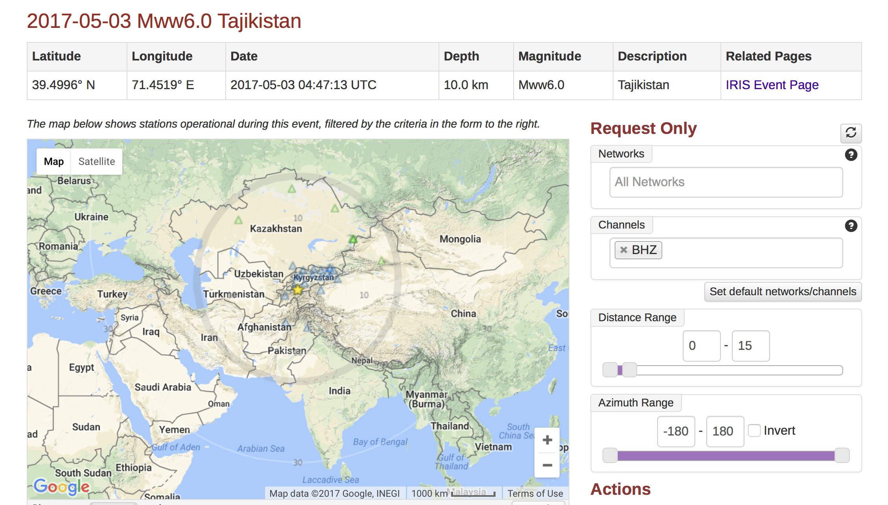
The object of the next exercise is for everyone to use an IRIS data request tool of their choice to request data for the following earthquake
Training in Network Management Systems and Analytical Tools for Seismology • 23–27 October 2017 • Baku, Azerbaijan

Slide 37
Working with the FDSN
Today’s Problem
2017-05-03 04:47:13 UTC MWW6.0 Tajikistan
latitude: 39.4996 longitude: 71.4519
Get data from as many stations as you can within
• 30 degrees of the epicenter
• LHZ Channels
• 60 minutes of data
• Get data in miniSEED
Training in Network Management Systems and Analytical Tools for Seismology • 23–27 October 2017 • Baku, Azerbaijan

Slide 38
Connecting with IRIS
HTTP://WWW.IRIS.EDU

Slide 39

Make use of the IRIS Resources
Training in Network Management Systems and Analytical Tools for Seismology • 23–27 October 2017 • Baku, Azerbaijan

